Slide 1



Welcome To Digital Egypt!
E-COMMERCE WEBSITE

Slide 2


TECHNOLOGYS
-Front-End: HTML-CSS-BootStrap-Java Script
-Back-End: PHP - Laravel - MySQL
-Apps:XAMPP - VSC (PHPSTORM)
-Control System:Git
-Platform:GitHup

Slide 3

WHY
-Simple & Clean Code: Laravel offers easy-to-read syntax.
-MVC Architecture: improving organization and scalability.
-Eloquent ORM: Developer work with DB using PHP instead of SQL.
- Blade Templating Engine: easily create dynamic HTML pages ,It -supports template inheritance, loops, conditional statements.

Slide 4


MISSION
empowering businesses to grow through efficient management tools and scalable technology. We are committed to offering a platform that ensures trust, reliability, and convenience for both shoppers and merchants.
VISION
We aim to push boundaries using advanced tech for transformative solutions.

Slide 5





Hanover and Tyke
OUR SERVICES
We strive to provide top-notch service.

Slide 6


USER-FRIENDLY EXPERIENCE
PRODUCT MANAGEMENT & FLEXIBILITY
provide a seamless, intuitive shopping experience
SCALABILITY & PERFORMANCE
Laravel’s caching, task scheduling, and queue management tools will enable us to maintain performance under heavy loads.
SECURE TRANSACTIONS
easily manage product listings, inventory, and pricing.
ecurity features like encryption, authentication, and protection against SQL injections

Slide 7
MVC Architecture
Model
View
Controller
Routes

Slide 8
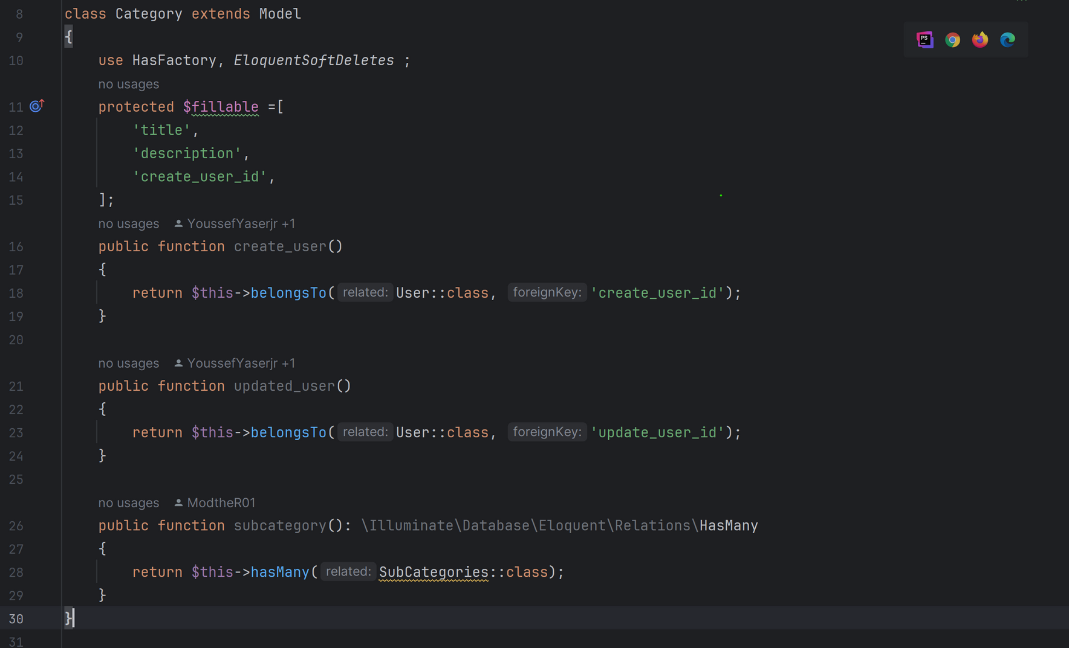
1-MODELS:WAY TO INTERACT WITH DATABASE
key points:
Example :
relationships:
One-to-One: hasOne()
One-to-Many: hasMany()
Many-to-Many: belongsToMany()

Slide 9
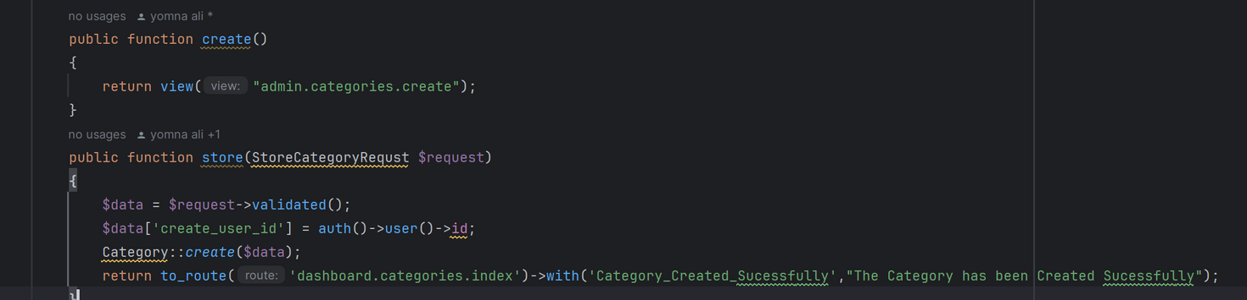
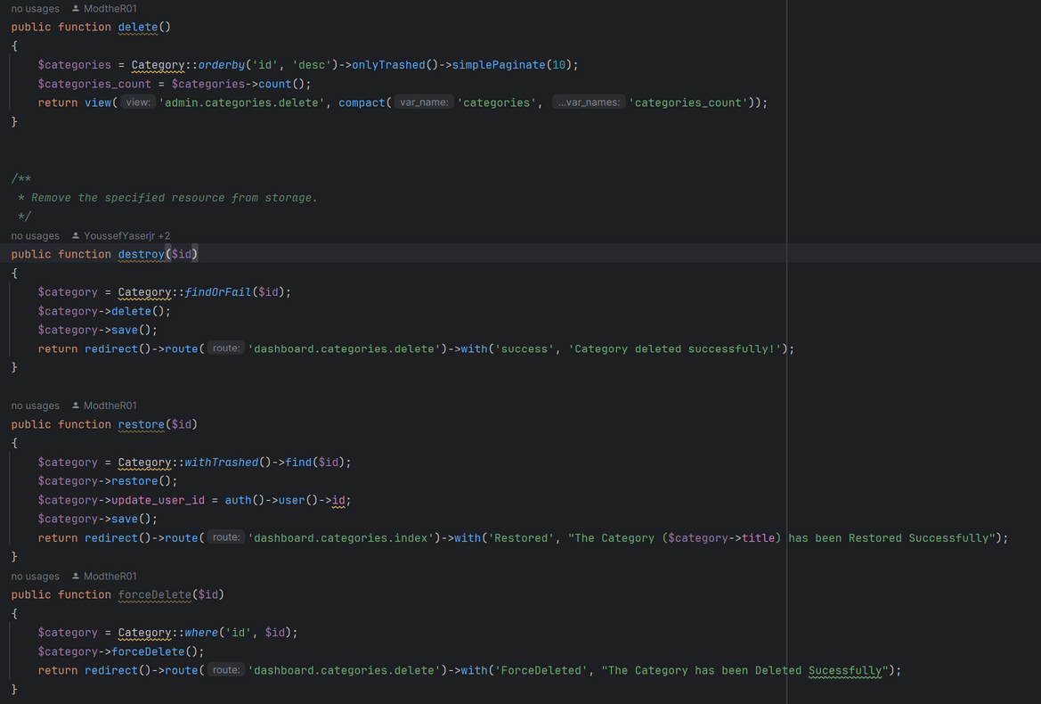
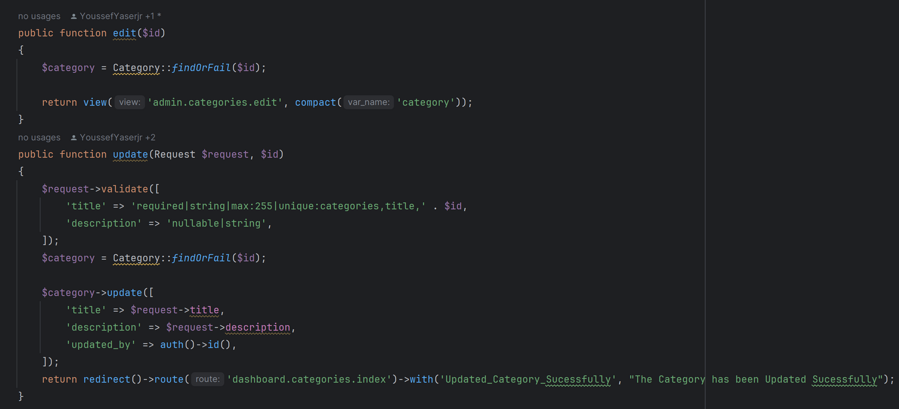
CRUD Operations (Create, Read, Update, Delete)

Slide 10
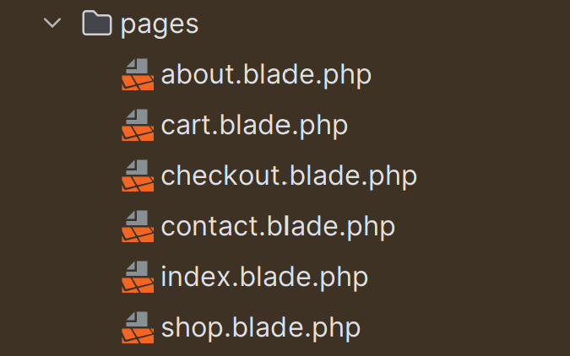
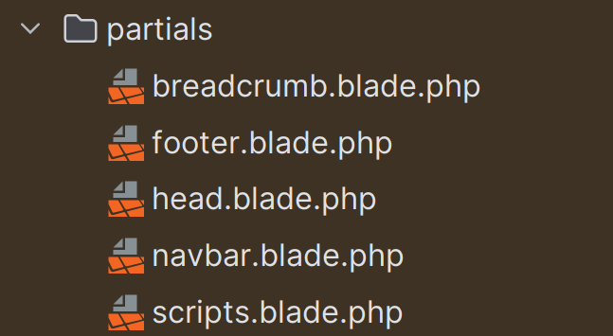
2-Views:responsible for displaying the data to the user in a formatted way
key points:
1-Blade Templating Engine:create reusable templates, include dynamic content

Slide 11
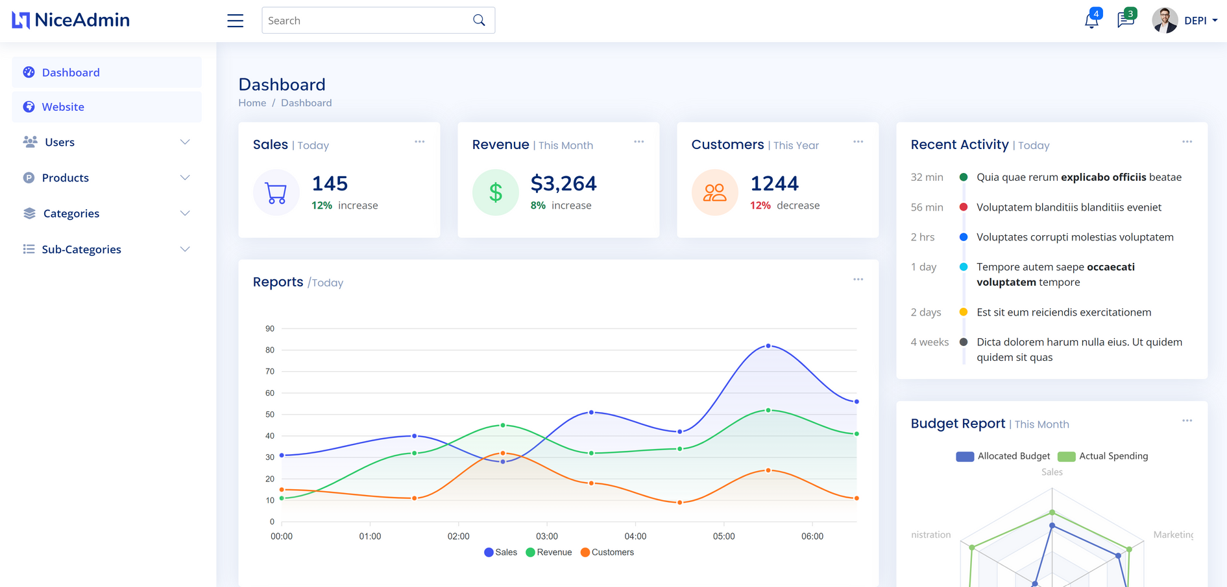
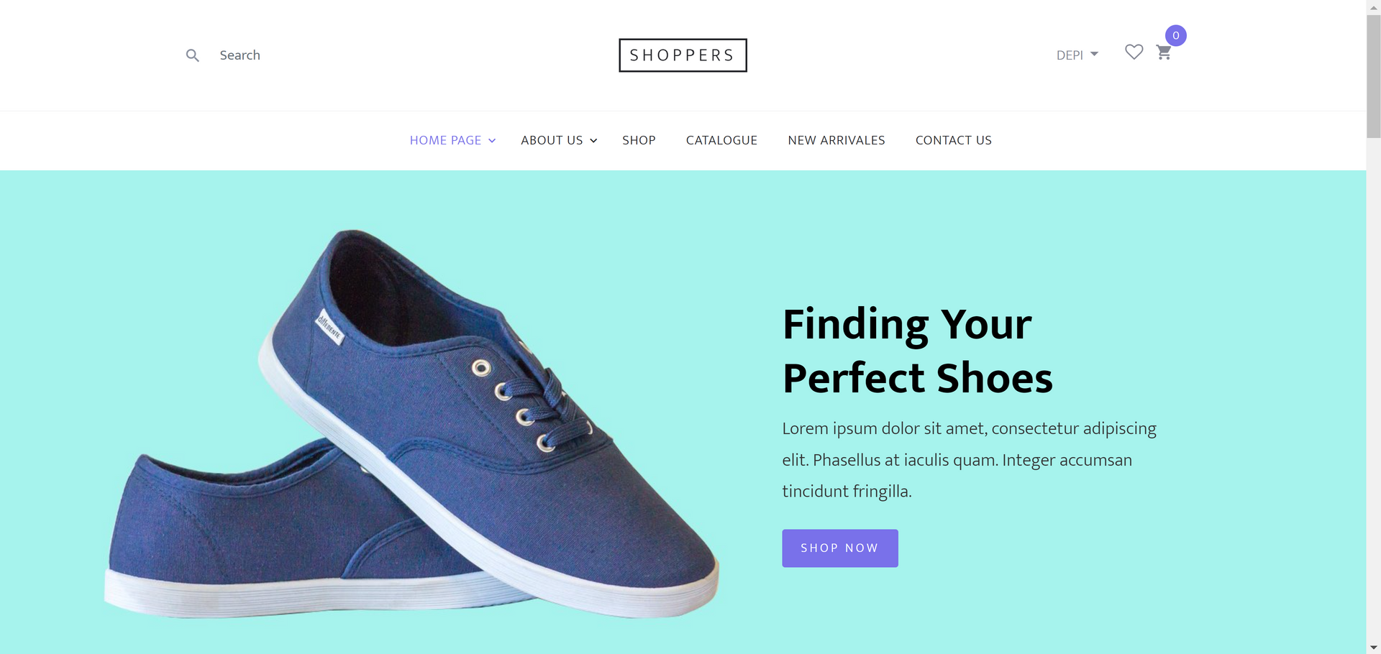
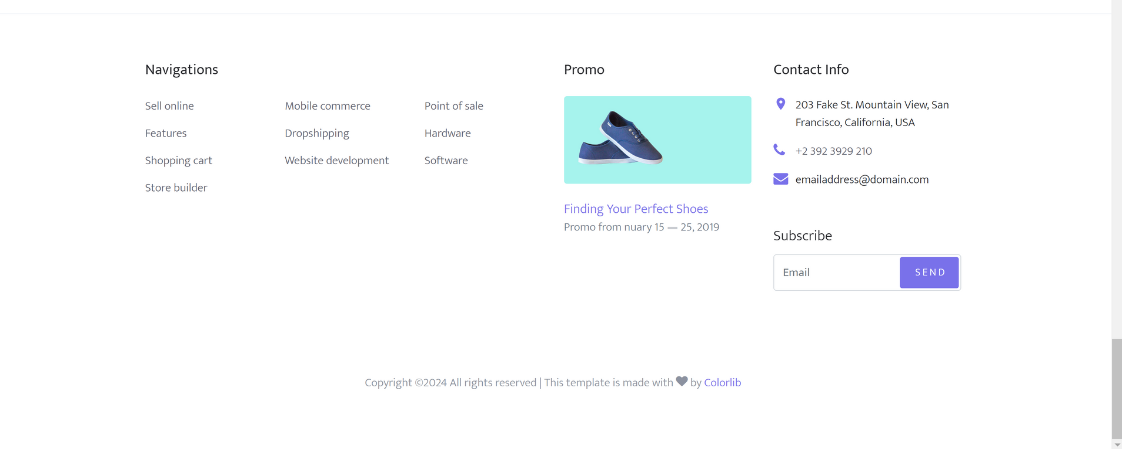
-Layouts:support the concept of layouts, which allows you to define a common layout (sidebar, navbar and footer) and extend it in individual views.

Slide 12
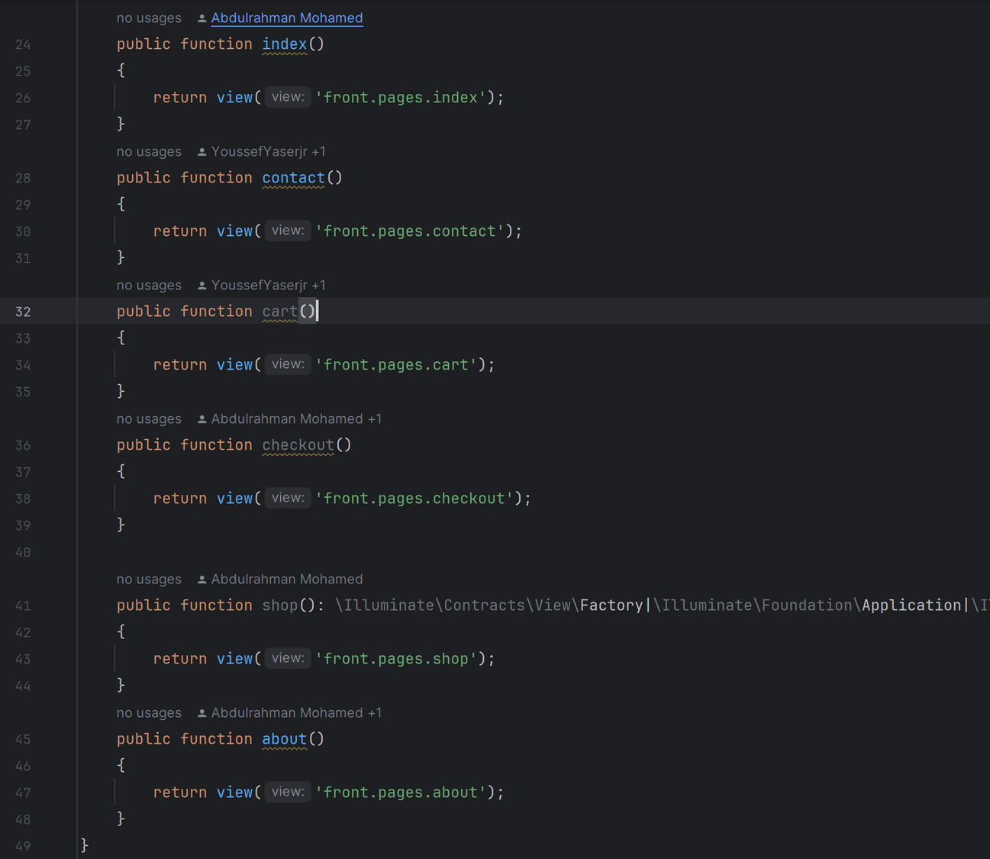
3-controller :class that handles the incoming requests to your application
-Key Points:
1-Resource Controllers: Laravel provides a way to create resourceful routes and controllers
2-Middleware: Controllers can use middleware, allowing you to filter HTTP requests entering your application.
3-Handling and Validation: Controllers are also responsible for handling form submissions and validating input data

Slide 13
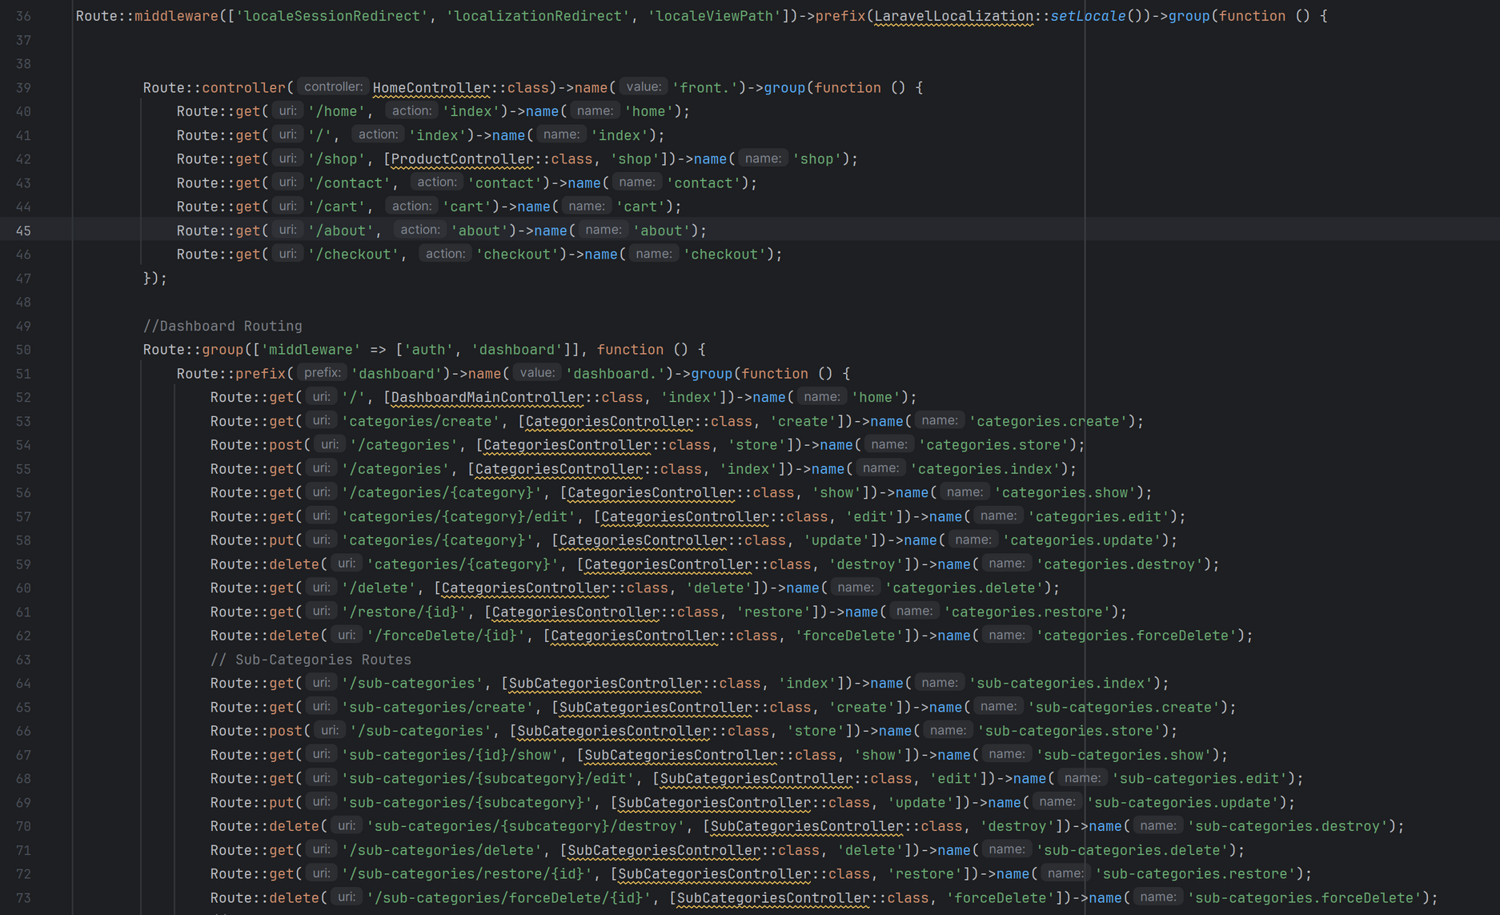

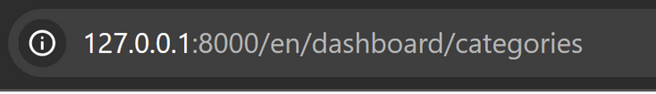

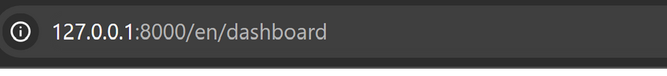
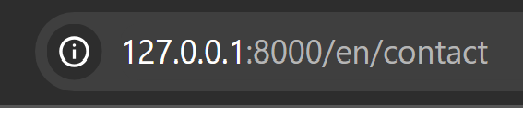
4-Routes: define the URLs or endpoints that your application responds to and the logic

Slide 14
MEET THE TEAM
YOUSSEF YASER EMAM
AL-MODASER OSAMA AHMAD
ABDELRAHMAN MOHAMMED
MARWA REDA
YOUMNA

Slide 15

CONCLUSION
We're happy to have built a great online store that does everything you need. It shows we can do tough jobs and find easy ways to help.

